Slide 1
Physical Electronics lecture-9
Junction-Diode
Dr. Suha I. Al- Nassar

Slide 2
Junction-Diode
The p-n junction is the junction between an n-type semiconductor and a p-type semiconductor. It is fabricated by introducing donor impurities into one side of an intrinsic semiconductor crystal and acceptor impurities into the other side. The transition between the two regions occurs in a very small distance, typically 0.5 μm.

Slide 3
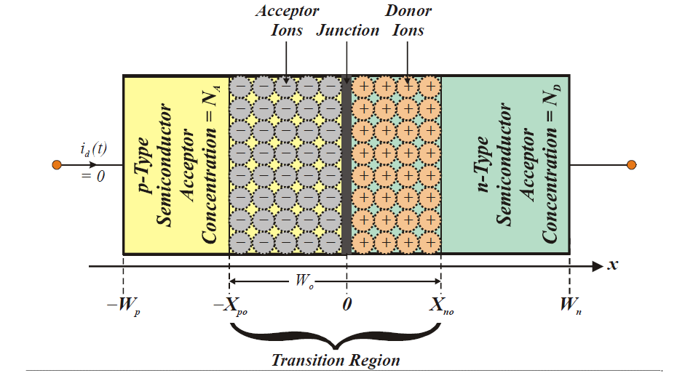
The below figure illustrates the cross section of a p-n junction where the donor ions are represented by positive signs and the acceptor ions are represented by negative signs. Initially, we assume that the only charge carriers in the n-type side are free electrons and that the only charge carriers in the p-type side are holes. The p-type region is doped with acceptor impurities at an average concentration of NA (in units of atoms -per- cm3), while the n-type volume has an average donor impurity concentration of ND. Although the impurity concentration profiles in either diode region are rarely constant, independent of position variable x in the diagram, the salient features of diode operation can be gleaned by assuming that these doping concentrations are constant at their respective average values, or at least at some appropriately corrected average values. The thickness of the p-region is noted as Wp, while that of the n-type crystal is Wn. On the other hand, dimensions L and H define the cross section junction area, say A, as A= LH.

Slide 4
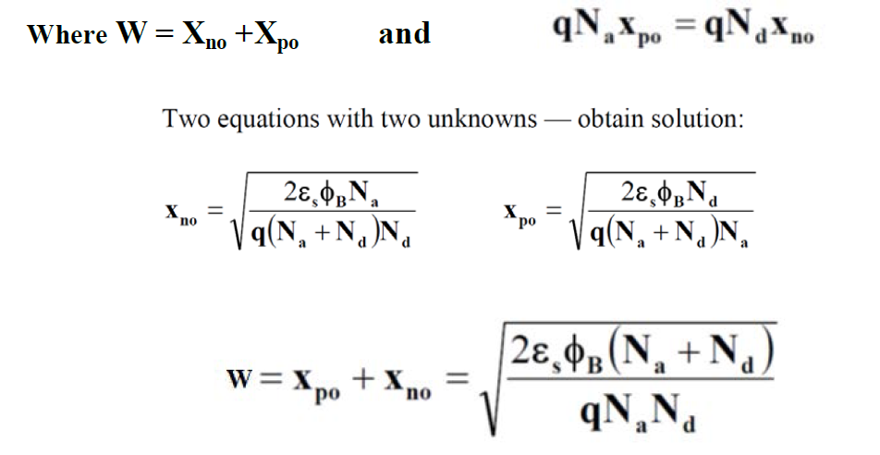

Slide 7
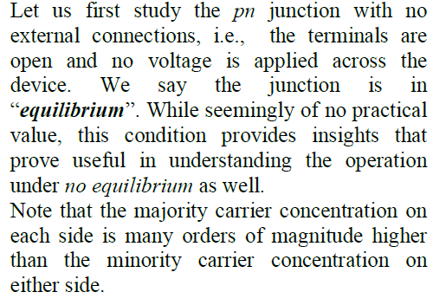
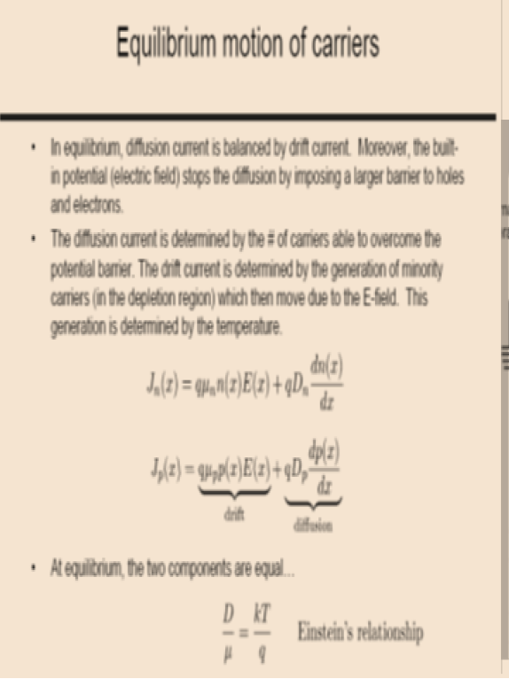
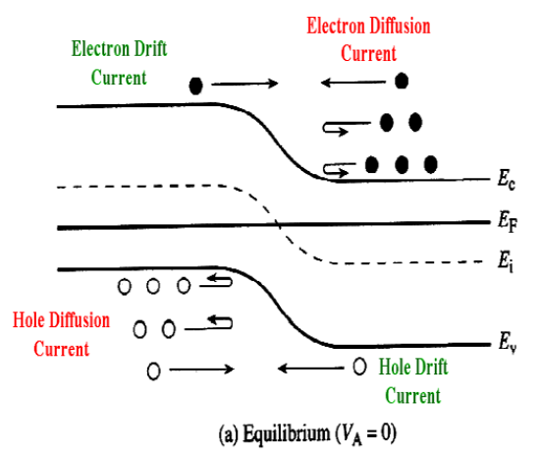

Slide 12
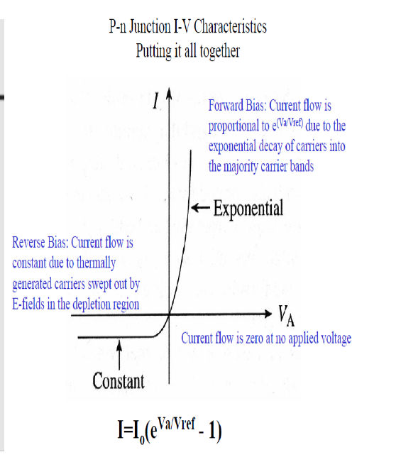

Slide 15
